Slide 1
API Management
Publish, manage, secure, and analyze your APIs in minutes
SignOn 2019
Raphael Bickel

Slide 2
Agenda
Main topic: Segoe UI Semilight, size 28pt
Segoe UI, size 20pt for second level
Segoe UI, size 16pt for third level

Slide 3
Digital Transformation runs on APIs
Connected experiences
APIs
Services and data
Notes:
API helps Transformation and optimization
Enable new business models
Centric strategies
Innovative business models
New connected experiences
Are enabled by API
APIs are abstraction. Decoupled consumption from implementation
APIs are reusable. Long period of time, used by many customers
HTTP APIs. Extremely well adopted. Standards, Open APIs
Available on any platform by any programming language
Building and consuming an API is a solved problem
Flexibility
Can change the backend architecture, location, transport without impacting the API
Front door for authentication, metering
Evolve backend APIs
Enable
Enable developers to find APIs
Test APIs

Slide 4

API management solves API-related challenges
Discover
Learn
Get access
Try
SDKs and samples
Get help
Connected experiences
Abstract
Secure and protect
Manage lifecycle
Monitor and measure
Onboard developers
Monetize
Consume
Mediate
Publish
Developer portal
Gateway
Azure portal
APIs
Developers
(use APIs)
Publishers
(provide APIs)
Services and data
Notes:
Gateway is a mediation layer

Slide 5
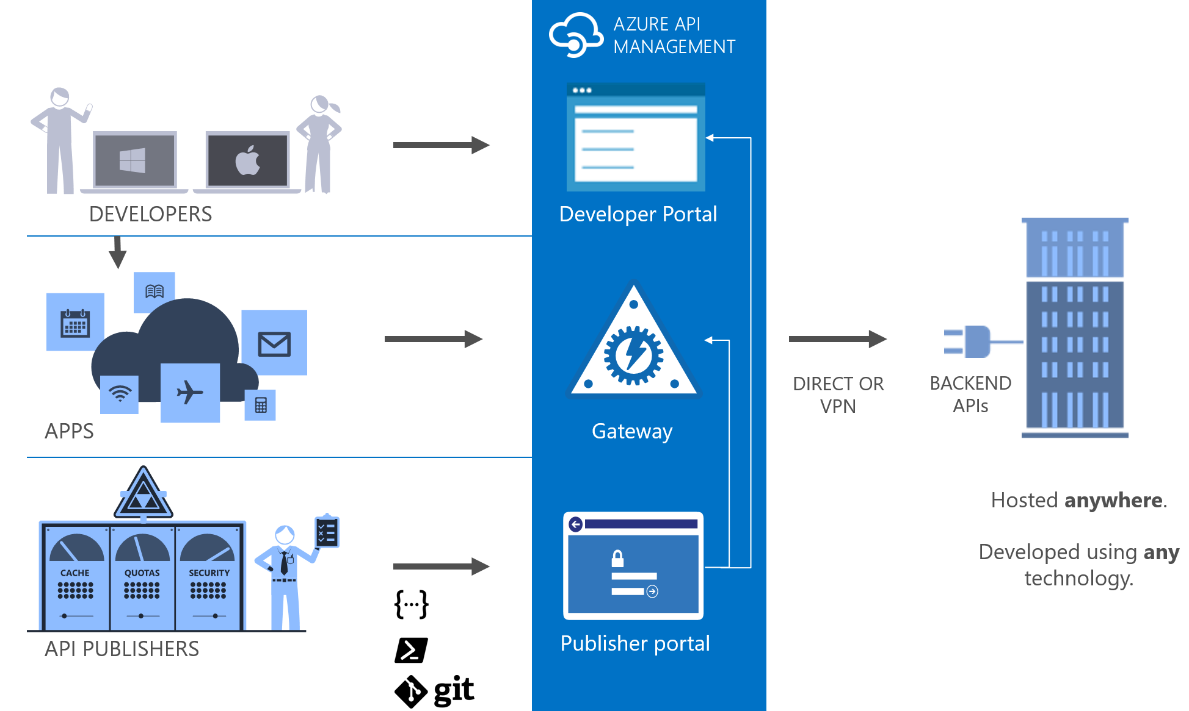
API Management

Slide 6
Integration
SOAP / REST / …
Vnet integration
VPNs
Backend authentication
HTTP Basic
Client Certificate
Keys / Custom

Slide 7






Security
Authentication
Username/password
Azure AD
Facebook, Google, Twitter
Open Auth 2.0
Open ID Connect
Authorization
Product / Subscription based
Jwt token validation
Claim
Audience
Issuer

Slide 8
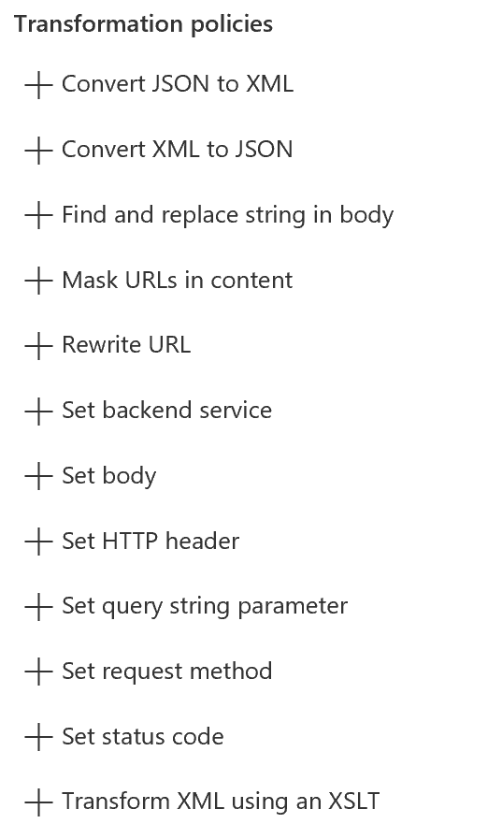
Content transformation
Content type conversion
XML to JSON
JSON to XML
XSLT transformation
Find/Replace
Mask URLs in content
Mocking
Custom processing with C#

Slide 9
Performance and scalability
Throttling
Caching
BYOK
Horizontal scaling
Cross region

Slide 10


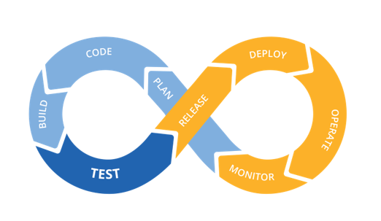






DevOps with API Management
ARM Templates
API Management
App Insights
Azure Monitor

Slide 11
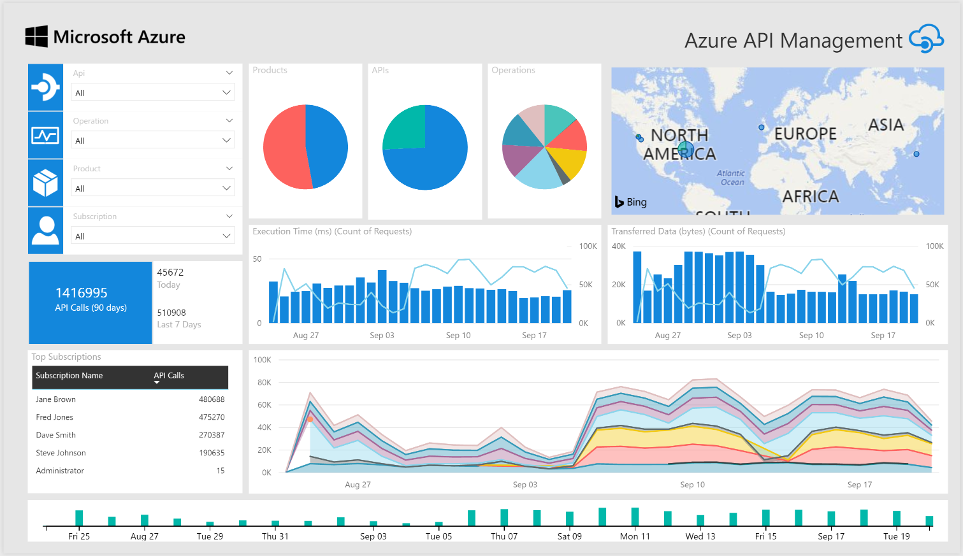
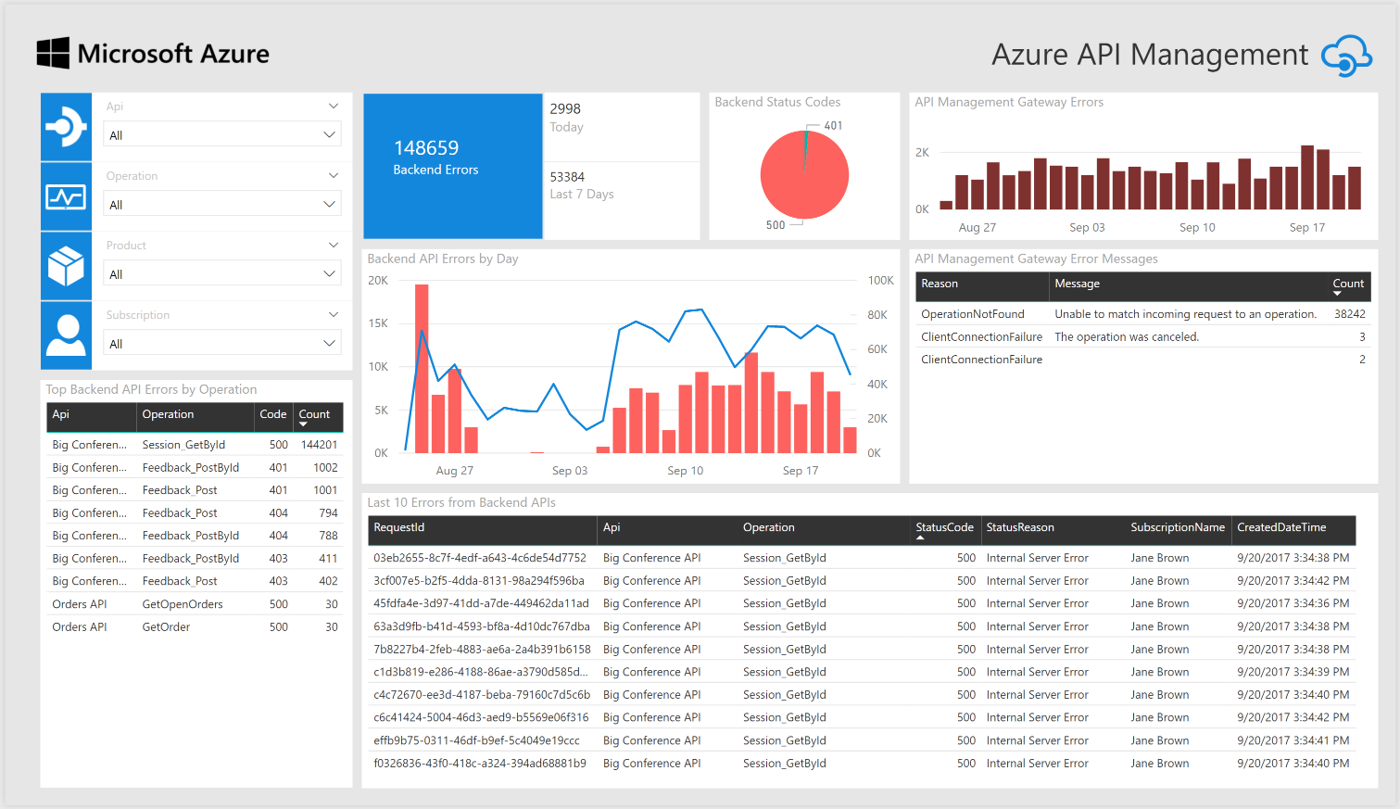
Monitoring and troubleshooting
API Inspector
Built-in reports
Power BI
Azure Monitor metrics
Event Hub
Application Insight

Slide 12
And more
Custom domains/SSL
Scaling
Multi-region
Developer dashboard
SDKs and samples
VPN
Backend authentication
HTTP Basic
Keys
Client Certificate

Slide 13
Demo
Raphael Bickel
Notes:
Import CalcAPI (http://calcapi.cloudapp.net/calcapi.json)
- Present flow and policies
Present Developer portal
Present Revisions and versioning
- Add Policy Set Request Header: accept:application/json
Setup OpenIdConnect authentication
Setup provider
Show authentication from portal
Setup Authorization
Enable rate-limit
Bind an azure function to add operation “Power”
Create Function App (named Power)
Add Name table :
Function_url (rabickel-aritmetic.azurewebsites.net/api)
Function_key (api key)
Create new API operation with following policies:
<set-backend-service base-url="https://{{Function_url}}" />
<set-query-parameter name="code" exists-action="override">
<value>{{Function_key}}</value>
</set-query-parameter>

Slide 14
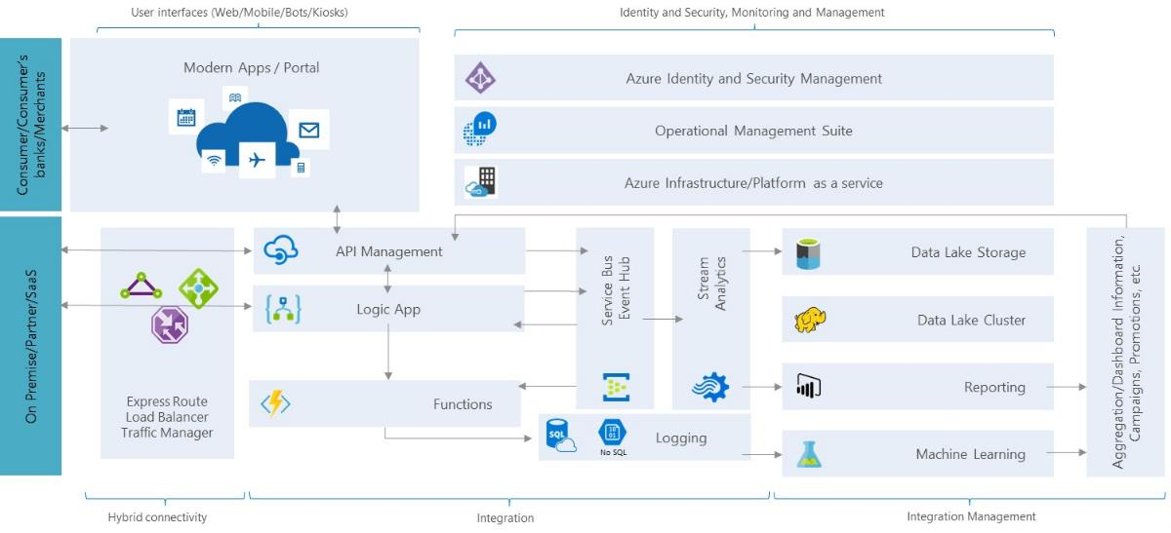
Microsoft Open Banking Platform​ as a Service and API’s
Notes:
Microsoft Services solution to help banks implement an open banking platform that enables disruptive transformation and fuels innovation with strategic partnerships. Solution leverages the Azure ecosystem of advanced technologies to provide a competitive advantage while providing a secure infrastructure to safeguard digital assets for the open API economy.​
Conceptual Architecture

Slide 15

Questions
Raphael Bickel ¦ Cloud Solution Architect ¦ Microsoft Geneva
Phone: +41 (78) 844 6033 ¦ Email: raphael.bickel@microsoft.com
Microsoft, 2-4 route de Peney, CH-1214 Vernier

